Slide 1




Towards Large Reasoning Models: A Survey of Reinforced Reasoning with Large Language Models
Mehak Fatima 21L-5614
Minahil Mobin 21L-5679
Raveeha Zubair 21L-6222

Slide 2
Problem Statement
LLMs struggle with complex reasoning tasks requiring multi-step thinking, logical consistency, and decomposition.
This survey explores how to enhance and evaluate reasoning in LLMs.
Focus is on Reinforced Reasoning, combining:
Reinforcement Learning (RL)
Search algorithms
Chain-of-Thought (CoT) reasoning
Goal: Build Large Reasoning Models (LRMs) with stronger, more reliable reasoning abilities.

Slide 3

Introduction
LLMs like ChatGPT are big AI models trained on huge amounts of text.
They’re not just good at writing — they can think step-by-step like humans.
New methods like "Chain of Thought" help them explain their answers clearly.
But training them to reason well needs a lot of step-by-step examples, which is hard for humans to label.
Now, researchers let LLMs learn by themselves using trial-and-error and reward systems.
This creates a cycle of improvement, making models smarter over time.
The goal: Build Large Reasoning Models — not just chatbots, but AI that can truly think and solve real problems.

Slide 4
Background
Steps | What It Does | Why It Matters
Pretraining | Trained on Huge amount of data Tries to guess next word | First step of learning
Fine Tuning | Follows instruction better Gives better results | Gives a boost to model
Alignment | Human ranks model responses A reward model is trained to understand what makes a good response LLM trained using RL | Breaking model into steps Learns Get Feedback and improve gradually
Prompting | Chain of thoughts Think step by step | Multiple Paths Explored
Agentic Workflow | Samples given in the prompt Adjusts to new task or user Work together with humans to solve problems | A mind of it’s own

Slide 5
Data Construction: From Human Annotation to LLM Automation
Human Annotation
High-quality but costly
Crucial for complex tasks (e.g., RLHF, math reasoning)
LLM Automation
Cost-effective & scalable
Outcome Annotation: Tool use, self-refinement
Process Annotation:
Stronger LLMs label steps
Monte Carlo & MCTS simulations
PRM: Train reward models to refine steps

Slide 6
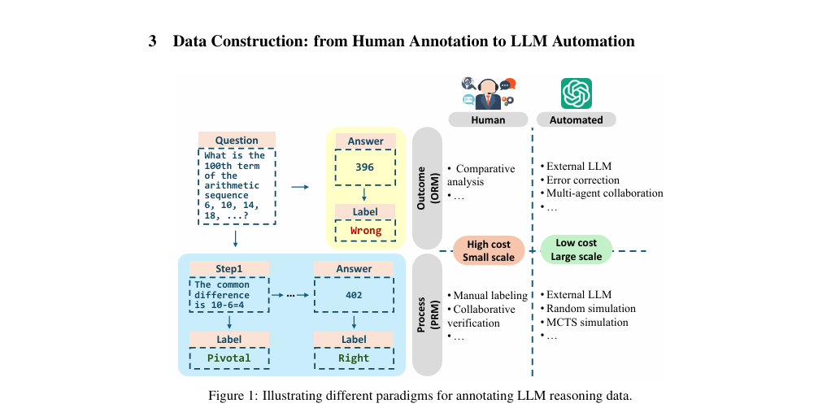
Importance of Instruction Following

Slide 7

Training LLMs to Think and Reason
Supervised Fine-Tuning (SFT):
Uses labeled datasets to adapt pre-trained LLMs for specific tasks (e.g., math, logic).
Introduced Chain-of-Thought (CoT) prompting to improve multi-step reasoning.
Limitations: Needs high-quality labels, risks catastrophic forgetting, costly for large models.
Reinforcement Learning (RL):
Trains LLMs using reward signals from human (RLHF) or AI feedback (RLAIF).
Aligns models with human intent for better reasoning and ethical behavior.
Constitutional AI reduces reliance on human labels using predefined principles.
Direct Preference Optimization (DPO):
Avoids reward models by learning directly from pairwise human preferences.
ODPO improves DPO by weighting the degree of preference, enhancing reasoning and alignment.
Outcome Reward Model (ORM):
Rewards based on final answers; used in ReFT and VinePPO.
Tackles the credit assignment problem in reasoning by Monte Carlo methods.
Process Reward Model (PRM):
Gives step-by-step feedback to guide reasoning paths.
Used in models like SELF-EXPLORE and DeepSeekMath for math problem-solving.
Enables better generalization and accuracy in multi-step reasoning.

Slide 8
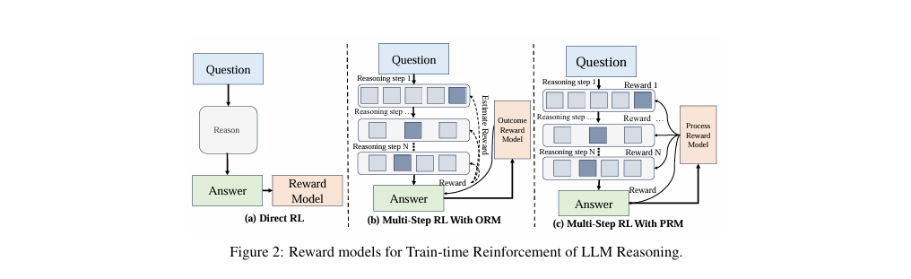
Importance of Instruction Following

Slide 9
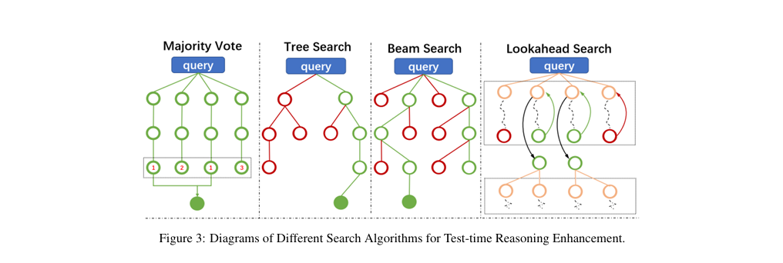
Importance of Instruction Following

Slide 10
Smarter Inference: Prompts to PRMs
Smarter Inference Without Retraining:
Instead of just training-time learning, LLMs can reason better at test-time using smart prompts and guided search.
Techniques like Chain-of-Thought (CoT) and Tree-of-Thoughts (ToT) help models reason step-by-step for better accuracy.
Process Reward Models (PRM):
PRMs guide models during inference by scoring each reasoning step, not just the final output.
Used in advanced models (e.g., OpenAI o1) for deeper, process-aware reasoning.
Popular Inference Strategies:
Majority Vote: Run multiple inferences, pick most common answer.
Tree Search (MCTS): Explore multiple reasoning paths, improve decisions over time.
Beam Search: Keep top-K best sequences to enhance output quality.
Lookahead Search: Simulate future steps using PRM to make better current choices.
These methods improve LLM performance without changing model weights—just smarter use at inference time.

Slide 11
Path Toward Large Reasoning Models
Development of OpenAI o1 Series:
o1 Release (Sept 2024): Breakthrough AI model excelling in complex tasks like math, coding, and scientific problem-solving.
o3 Release (Dec 2024): Upgraded version of o1 with "doctorate-level intelligence."
Key Achievements:
Gold medal in International Math Olympiad.
PhD-level performance in physics, chemistry, and biology.
Key Findings:
Effective Knowledge Integration: 83.3% success in competitive programming, demonstrating structured problem-solving and domain knowledge integration.
Systematic Problem Decomposition: Consistent high accuracy in increasingly complex tasks (e.g., math exams, programming).
Reliable Reasoning: Maintains coherence in complex planning tasks, adapting to dynamic constraints and long-horizon problems.
New Scaling Laws: Improved performance with extended reasoning time (e.g., 10,000 submissions).
Open-Source Attempts:
OpenR, Rest-MCTS, o1 Replication Journey, LLaMA-Berry: Open-source frameworks replicating o1's reasoning capabilities through various strategies (reinforcement learning, Monte Carlo Tree Search, and pairwise optimization).

Slide 12

Other Test-time Enhancing Techniques
Verbal Reinforcement Search
Uses feedback loops to refine outputs.
Individual agents
Multi-agent systems
Embodied agents
Memory-based Reinforcement
Adds memory modules to retain past experiences.
Experiential Learning
Reflective Learning
Concept Learning
Agentic System Search
Designs LLM-powered agents to explore solutions dynamically.
Enables long-term planning, interaction, and complex task solving.

Slide 13
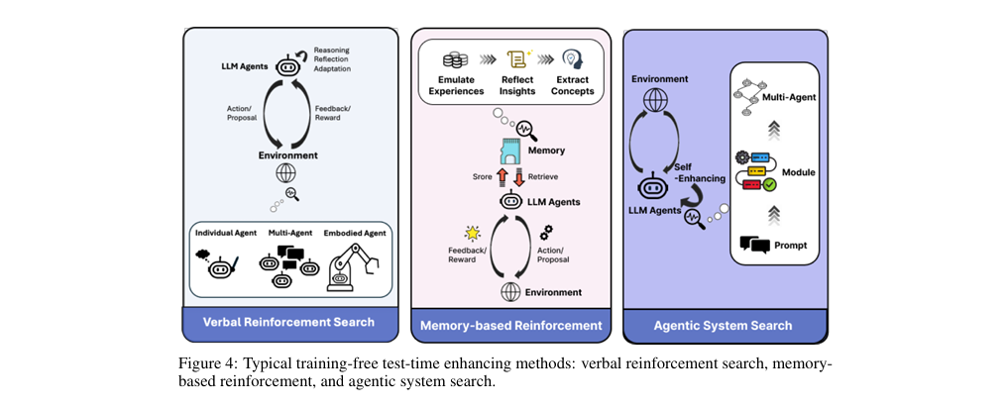
Training-Free Test-Time Enhancements for LLMs

Slide 14

Evaluation Benchmarks
Mathematical Word Problems
Benchmarks range from basic arithmetic to Olympiad-level reasoning.
Math Word Problems
Advanced Reasoning
Geometric Reasoning
Theorem Proving
Cross-Modal Reasoning
Logical Problems
Evaluate LLMs' capabilities in systematic logical reasoning
Deductive Reasoning
Inductive Reasoning
Abductive Reasoning
Commonsense Problems
Evaluate LLMs' grasp of everyday knowledge and reasoning
Social interaction
Adversarial text
Comprehensive evaluation

Slide 15
Evaluation Benchmarks
Code Problems
Assess LLMs’ ability to understand, write, and debug code
Real-world scenarios
Data science
Program synthesis
Agent Problems
Assess LLMs' ability to act as agents by planning, using tools, and performing tasks
Web environment
E-commerce
Comprehensive evaluation

Slide 16
Advancing LLM Reasoning
Inspirations from the recent advances
Scaling Law of Post-Training Phases
Generating High-Quality Data
Slow-thinking and reasoning
OpenAI O1 series focuses on post-training slow-thinking, inspired by human cognition, but with limited implementation.
Theoretical analysis of slow-thinking in LLMs is still lacking, with current models showing significant differences in tasks like text generation and problem-solving.
Downstream applications and open problems
Reasoning technologies are improving and being used in more areas, like city planning and scheduling.
Combining LLMs with external evaluators could help improve answers and create better reward models.

Slide 17
Conclusion
LLMs have advanced in reasoning capabilities with innovations like "thought" steps and reinforcement learning.
These advancements are enhancing AI's ability to solve complex tasks and reshape real-world applications.

Slide 18
THANK YOU!

